Slide 1
PART 2 Individual Behaviors and Processes in Organizations
CHAPTER 4
Individual Values, Perceptions, and Reactions
Ricky W. Griffin/Jean M. Phillips/Stanley M. Gully, Organizational Behavior: Managing People and Organizations, Thirteenth Edition. © 2020 Cengage. All Rights Reserved. May not be scanned, copied or duplicated, or posted to a publicly accessible website, in whole or in part.

Slide 2
Chapter Learning Objectives After studying this chapter you should be able to:
Discuss how attitudes are formed, describe the meaning of cognitive dissonance, and identify and describe three important work-related attitudes.
Describe the role and importance of values and emotions in organizational behavior.
Describe basic perceptual processes and how perception affects fairness, justice, and trust in organizations.
Discuss the nature of stress, identify the basic causes and consequences of stress, and describe how stress can be managed.

Slide 3
Attitudes in Organizations (1 of 4)
Attitudes
A person’s complexes of beliefs and feelings about specific ideas, situations, or other people
Structural components of attitudes
Cognition: the knowledge a person presumes to have about something
Affect: a person’s feelings toward something
Intention: component of an attitude that guides a person’s behavior

Slide 4
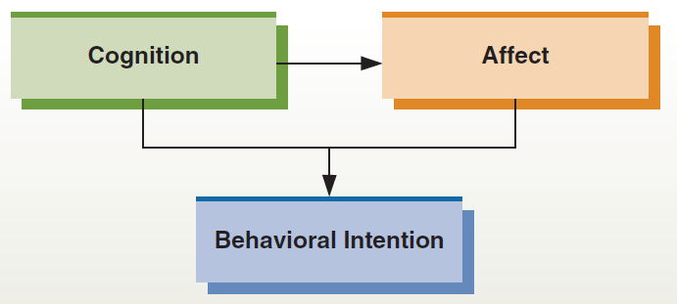
Attitude Formation
Figure 4.1
Attitudes are generally formed around a sequence of cognition, affect, and behavioral intention. That is, we come to know something that we believe to be true (cognition). This knowledge triggers a feeling (affect). Cognition and affect then together influence how we intend to behave in the future.

Slide 5
Attitudes in Organizations (2 of 4)
Cognitive dissonance
An incompatibility or conflict between behavior and an attitude or between two different attitudes
How to reduce cognitive dissonance?
Change the conflicting attitude
Change the conflicting behavior
Reason that one of the conflicting attitudes or behaviors is not important in this context
Seek additional information to better reason that the benefits of one of the conflicting attitudes or behaviors outweigh the costs of the other
Recognize that attitudes can change

Slide 6
Attitudes in Organizations (3 of 4)
Key work-related attitudes
Job satisfaction | Reflects our attitudes and feelings about our jobs
Organizational commitment | Reflects the degree to which an employee identifies with the organization and its goals and wants to stay with the organization
Employee engagement | Heightened emotional and intellectual connection that an employee has for his/ her job, organization, manager, or coworkers that, in turn, influences him/her to apply additional discretionary effort to his/her work

Slide 7
Attitudes in Organizations (4 of 4)
Types of organizational commitment
Affective commitment | Positive emotional attachment to the organization and strong identification with its values, and its goals; employees want to stay with the organization
Normative commitment | A feeling of moral or ethical obligation to the organization; employees stay because they believe it would be wrong to leave
Continuance commitment | Staying with the organization because of perceived high economic and/or social costs; employees stay because they feel they have to

Slide 8
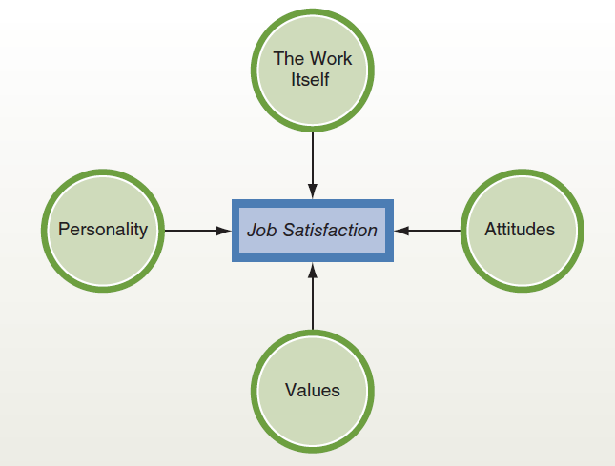
Influences on Job Satisfaction
Figure 4.2
Job satisfaction is one of the most important job-related attitudes in organizations. It reflects both our attitudes and our feelings about our job. Job satisfaction is strongly influenced by our personality, values, other attitudes, and the work itself.

Slide 9
Table 4.1 Top Three Worldwide Drivers of Employee Attraction, Retention, and Engagement for Different Age Groups
Top Drivers of Attraction for 18- to 24-Year-Olds | Top Drivers of Retention for 18- to 24-Year-Olds | Top Drivers of Engagement for 18- to 24-Year-Olds
Career advancement opportunities | Have excellent career advancement opportunities | Organization develops leaders at all levels
Competitive base pay | Work in an environment where new ideas are encouraged | Organization quickly resolves customer concerns
Learning and development opportunities | Satisfaction with the organization’s business decisions | Senior management is sincerely interested in employee well-being
Top Drivers of Attraction for 45- to 54-Year-Olds | Top Drivers of Retention for 45- to 54-Year-Olds | Top Drivers of Engagement for 45- to 54-Year-Olds
Competitive base pay | Organization’s reputation as a great place to work | Senior management is sincerely interested in employee well-being
Challenging work | Satisfaction with the organization’s people decisions | Improved my skills and capabilities over the last year
Convenient work location | Understand potential career track within the organization | The organization’s reputation for social responsibility
Source: Based on information provided in Exhibits 14, 15, and 16 of Towers Perrin Global Workforce Study—Global Report at http://www.towersperrin.com/tp/getwebcachedoc?webc=HRS/USA/2008/200803/GWS_Global_Report20072008_31208.pdf.

Slide 10
Values and Emotions in Organizations (1 of 4)
Values
Ways of behaving or end-states that are desirable to a person or to a group
Types of values
Terminal: reflect long-term life goals such as prosperity, happiness, secure family, and a sense of accomplishment
Instrumental: preferred means of achieving terminal values or preferred ways of behaving
Intrinsic: relate to the work itself
Extrinsic: relate to the outcomes of doing work

Slide 11
Values and Emotions in Organizations (2 of 4)
Conflicts among values
Intrapersonal: Conflict between the instrumental value of ambition and the terminal value of happiness
Interpersonal: Occurs when two different people hold conflicting values
Individual-organization: When an employee’s values conflict with those of the organization

Slide 12
Values and Emotions in Organizations (3 of 4)
Values differ around the world—leads to different managerial behaviors
Two major dimensions
Traditional versus secular-rational values: reflects the contrast between societies in which religion is very important and those in which it is not
Survival versus self-expression values: reflects the contrast between societies that emphasize economic and physical security and those that emphasize subjective well-being, self-expression, and quality of life, giving high priority to environmental protection, diversity tolerance, and participation in decision making

Slide 13
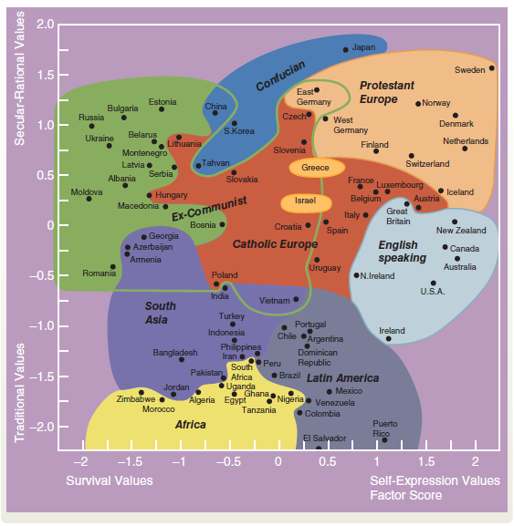
How Values Differ around the World
Figure 4.3
Values differ around the world. One useful way to understand differences in values is in terms of secular/rational values and survival/self-expression values. This figure illustrates how different regions of the world reflect these two sets of values.
Source: Inglehart, R., & Welzel, C. (2005). Modernization, Cultural Change and Democracy (p. 64). New York: Cambridge University Press. Based on the World Values Surveys, see http://www.worldvaluessurvey.Org.
Copyright © 2005 Ronald Inglehart and Christian Welzel. Reprinted with the permission of Cambridge University Press.

Slide 14
Values and Emotions in Organizations (4 of 4)
The role of emotions in behavior
Emotions
Intense, short-term physiological, behavioral, and psychological reactions to a specific object, person, or event that prepare us to respond to it
Moods
Short-term emotional states that are not directed toward anything in particular
Affectivity
The tendency to experience a particular mood or to react to things with certain emotions

Slide 15
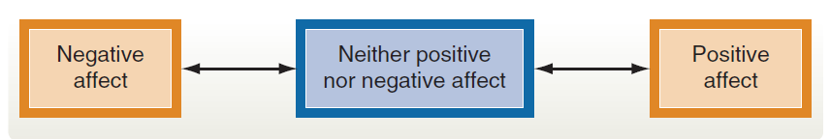
The Role of Emotions in Behavior
Affect and Mood in organizations
Positive affect | Reflects a combination of high energy and positive evaluation characterized by emotions like elation
Negative affect | Comprises feelings of being upset, fearful, and distressed
Figure 4.4
Positive and Negative Affect
Affect can vary anywhere along a continuum ranging from positive affect to negative affect. As illustrated here, it is also possible to fall in between these extremes and reflect neither positive nor negative affect.
Source: Thompson, E. R., Development and Validation of an Internationally Reliable Short-Form of the Positive and Negative Affect Schedule (PANAS), Journal of Cross-Cultural Psychology, 38(2), 227–242. © 2007 by SAGE Publications. Reprinted by Permission of SAGE Publications.

Slide 16
Perception in Organizations (1 of 5)
Perception
The set of processes by which an individual becomes aware of and interprets information about the environment
Basic perceptual processes
Selective perception: screening out information that we are uncomfortable with or that contradicts our beliefs
Stereotyping: categorizing or labeling people on the basis of a single attribute

Slide 17
Perception in Organizations (2 of 5)
Perception errors
Categorization | The tendency to put things into groups and then exaggerate the similarities within and the differences among the groups
Halo effect | Forming a general impression of something or someone based on a single (usually good) characteristic
Contrast effect | Evaluating someone by comparing them with recently encountered people
Projection | Seeing one’s own characteristics in others
First impression bias | The inability to let go of first impressions, particularly negative ones
Self-fulfilling prophecies | Treating people the way we categorize them and having them react accordingly

Slide 18
Perception in Organizations (3 of 5)
Attribution
The way we explain the causes of our own as well as other people’s behaviors and achievements, and understand why people do what they do
Are they due to the individual because of internal factors such as effort and ability?
Or are they due to the environment because of external factors such as luck, resources, and other people?

Slide 19
Perception in Organizations (4 of 5)
Three rules to evaluate whether to assign an internal or an external attribution
Consistency: Has the person regularly behaved this way or experienced this outcome in the past?
Distinctiveness: Does the person act the same way or receive similar outcomes in different types of situations?
Consensus: Would others behave similarly in the same situation or receive the same outcome?
Self-handicapping
When people create obstacles for themselves that make success less likely

Slide 20
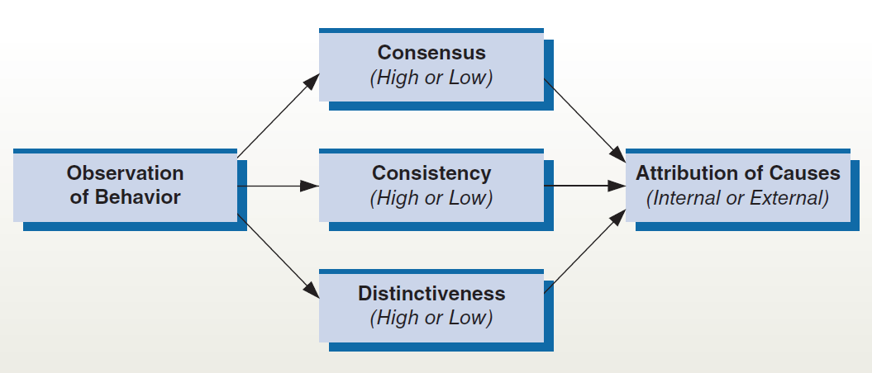
The Attribution Process
Figure 4.5
The attribution process involves observing behavior and then attributing causes to it. Observed behaviors are interpreted in terms of their consensus, their consistency, and their distinctiveness. Based on these interpretations, behavior is attributed to either internal or external causes.

Slide 21
Perception in Organizations (5 of 5)
Perceptions and fairness, justice, and trust
Organizational fairness—Employees’ perceptions of organizational events, policies, and practices as being fair or not fair
Distributive fairness—Perceived fairness of the outcome received, including resources distributions, promotions, hiring and layoff decisions, and raises
Procedural fairness—Addresses the fairness of the procedures used to generate the outcome
Interactional fairness—Whether the amount of information about the decision and process was adequate, perceived fairness of interpersonal treatment and explanations received during the decision-making process
Trust—The expectation that another person will not act to take advantage of us, regardless of our ability to monitor or control them.

Slide 22
Stress in Organizations (1 of 6)
Stress
A person’s adaptive response to a stimulus that places excessive psychological or physical demands on that person
The stress process (Selye)
General adaptation syndrome (GAS)
Identifies three stages of response to a stressor: alarm, resistance, and exhaustion
Sources of stress
Eustress: pleasurable stress that accompanies positive events
Distress: unpleasant stress accompanies negative events

Slide 23
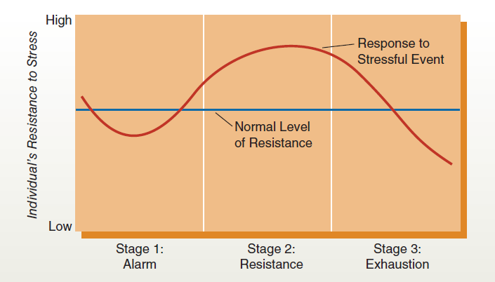
The General Adaptation System
Figure 4.6
The general adaptation syndrome (GAS) perspective describes three stages of the stress process. The initial stage is called alarm. As illustrated here, a person’s resistance often dips slightly below the normal level during this stage. Next comes actual resistance to the stressor, usually leading to an increase above the person’s normal level of resistance. Finally, in stage 3, exhaustion may set in, and the person’s resistance declines sharply below normal levels.

Slide 24
Stress in Organizations (2 of 6)
Common causes of stress
Organizational stressors: various factors in the workplace that can cause stress
Task demands—Associated with the specific job a person performs
Physical demands—Associated with the job’s physical setting and requirements
Role demands—Associated with the expected behaviors of a particular position in a group or organization
Interpersonal demands—Group pressures, leadership, interpersonal conflicts
Life stressors: life changes or traumas

Slide 25
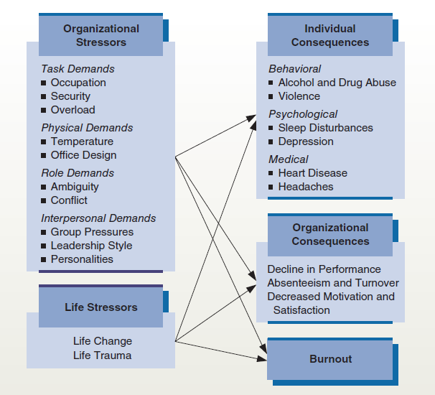
Causes and Consequences of Stress
Figure 4.7
The causes and consequences of stress are related in complex ways. As shown here, most common causes of stress can be classified as either organizational stressors or life stressors. Similarly, common consequences include individual and organizational consequences, as well as burnout.
Reference: Adapted from James C. Quick and Jonathan D. Quick, Organizational Stress and Preventive Management (McGraw-Hill, 1984) pgs. 19, 44, and 76. Used by permission of James C. Quick.

Slide 26
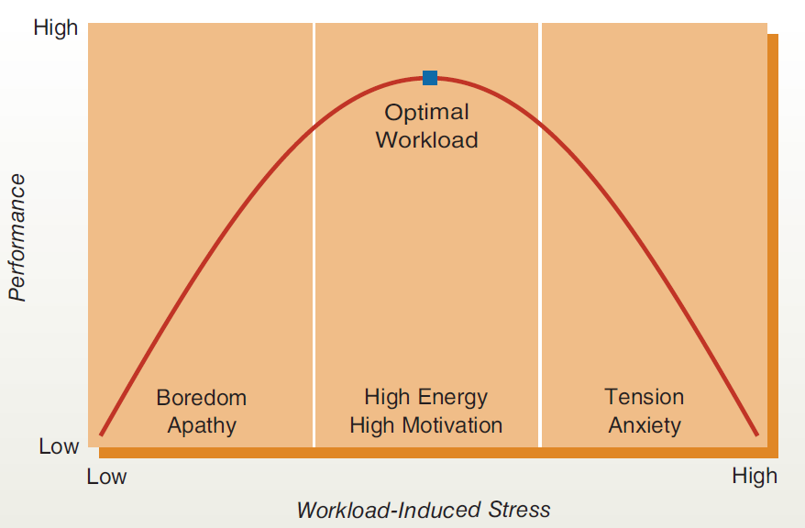
Workload, Stress, and Performance
Figure 4.8
Too much stress is clearly undesirable, but too little stress can also lead to unexpected problems. For example, too little stress may result in boredom and apathy and be accompanied by low performance. And although too much stress can cause tension, anxiety, and low performance, for most people there is an optimal level of stress that results in high energy, motivation, and performance.

Slide 27
Stress in Organizations (3 of 6)
Consequences of Stress
Individual consequences
Behavioral consequences
Psychological consequences
Medical consequence
Organizational consequences
Burnout
A general feeling of exhaustion that develops when an individual simultaneously experiences too much pressure and has too few sources of satisfaction

Slide 28
Stress in Organizations (4 of 6)
Managing and Controlling Stress
Individual Coping Strategies
Exercise
relaxation.
to develop and maintain support groups.

Slide 29
Stress in Organizations (5 of 6)
Organizational coping strategies
Institutional programs
Properly designed jobs and work schedules
Fostering a healthy work culture
Supervision—keep workloads reasonable
Collateral programs
Organizational programs specifically created to help employees deal with stress
Stress management, health promotion, employee fitness programs, career development

Slide 30
Stress in Organizations (6 of 6)
Work-life balance
Fundamental work-life relationships
work-life relationships
Interrelationships between a person’s work life and personal life
Balancing work-life linkages
Importance of long-term versus short-term perspectives
Balance needs of both wage earners in double-income families
Accept that there’s a work-life integration

Slide 31
Organizational Behavior in Action
After reading the chapter:
If your boss was not sure it would be worth the investment to change the company’s hiring practices to include an evaluation of applicants’ attitudes, what would you tell him or her?
Do you think that it would be easy to influence a subordinate’s attitudes, values, or emotions? Why? Which would have the largest influence on the employee’s behavior? Why?

